Slide 1
My numerical work related to neuronal network simulation
Kyle Chen Nov. 6, 2017

Slide 2
In general
Use delayed mutual information to investigate the causal relationship between spike train and local field potential(LFP)
Data was generated by conductance-based integrate-and-fire neuronal network;
Spike train was a sequence of binary value with specific timing step;
The summation of neuronal membrane current was treated as the LFP in my work;

Slide 3
Paradigm of simulation
Refractory Period | 2 ms
Poisson Driving Rate | 1.5 kHz
Synaptic Strength | 0.005
Feedforward Strength | 0.005
Total time duration | 600 s
Timing step | 0.03125 ms
1
2

Slide 4
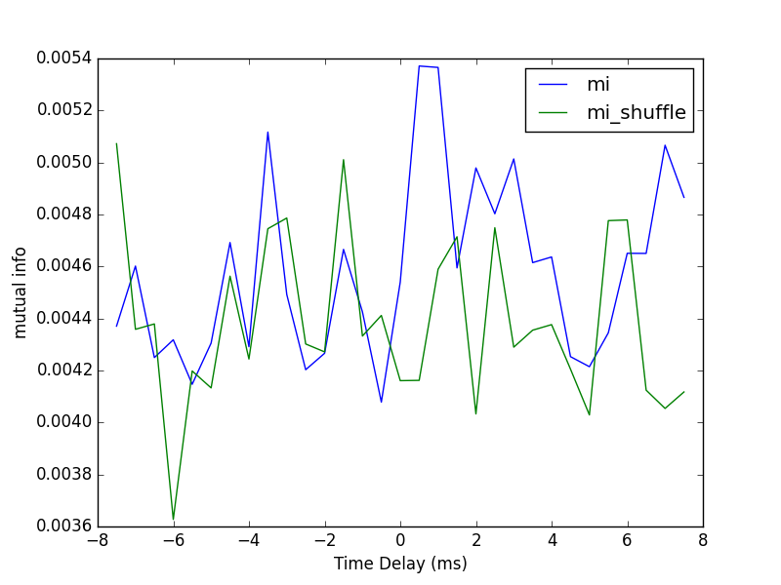
Sample Figure
The peak lying on the positive side of the graph indicates the same direction of neuronal information as the physical connection does.

Slide 5
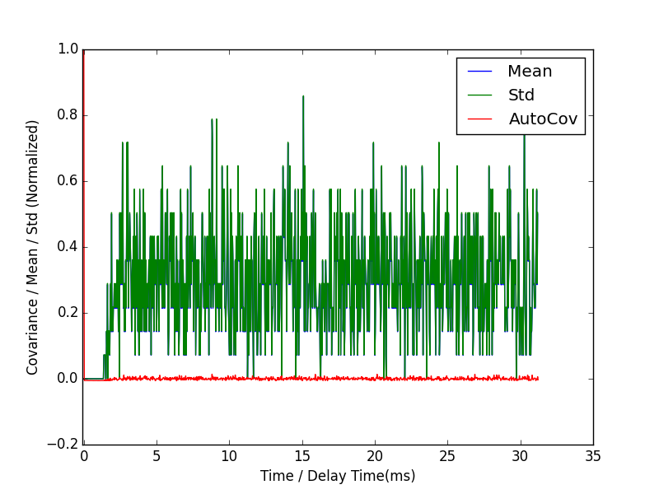
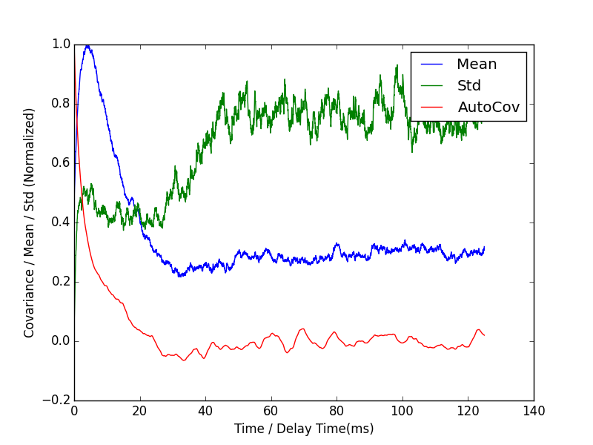
Details in mutual info measurements
Autocovariance of spike train of Neuron 1
Autocovariance of LFP of Neuron 1

Slide 6
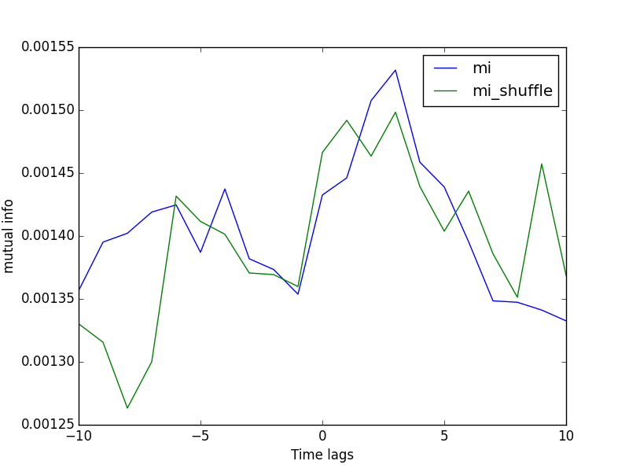
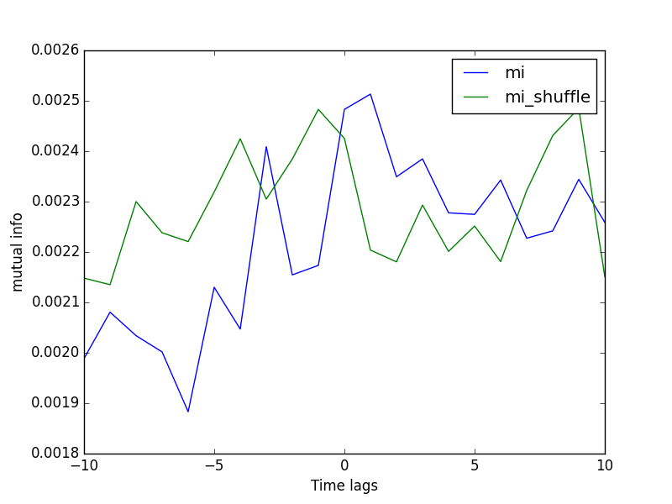
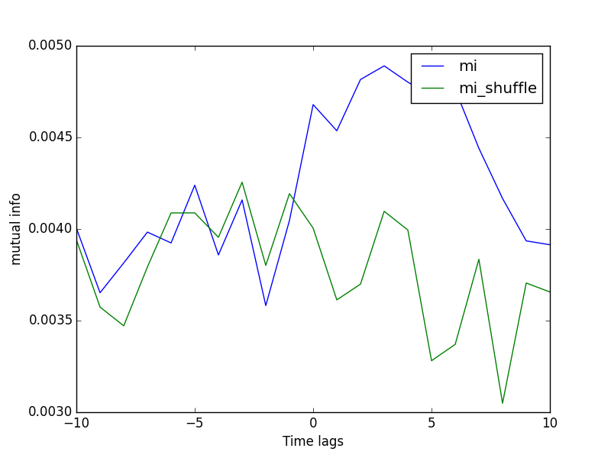
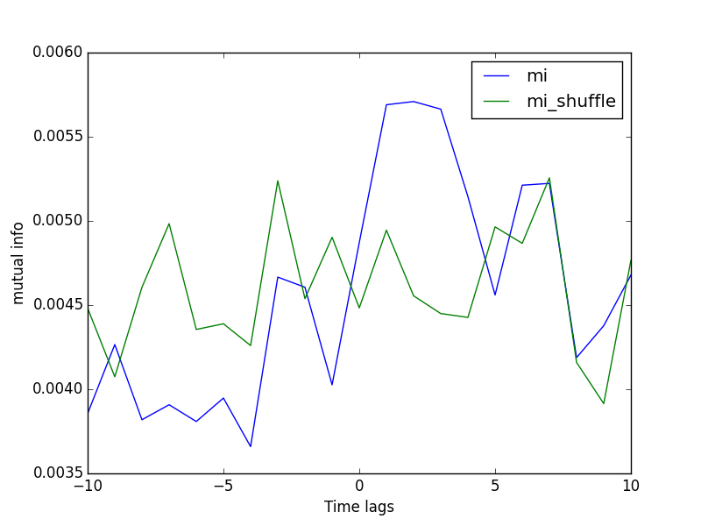
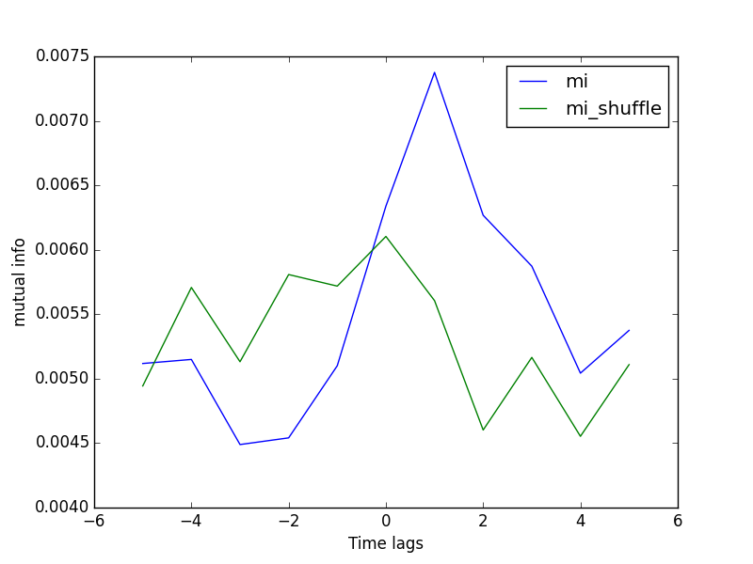
Different Timing Steps
Poisson Driving Rate | 1.5 kHz
Synaptic Strength | 0.008
Feedforward Strength | 0.005

Slide 7
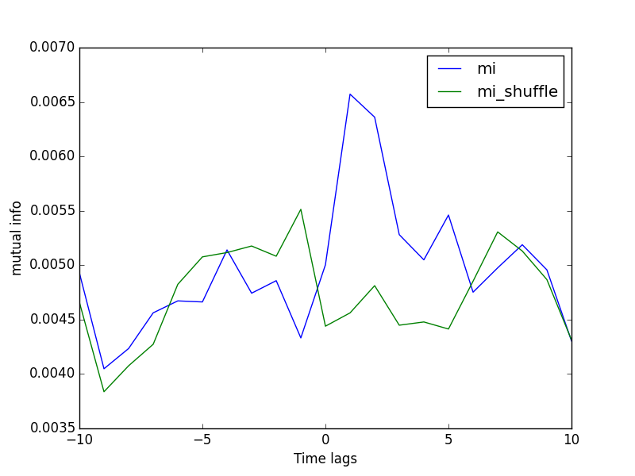
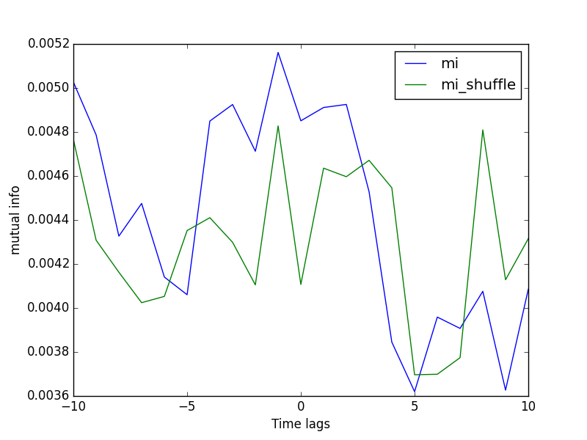
Indication of direction
Poisson Driving Rate | 1.5 kHz
Synaptic Strength | 0.0075
Feedforward Strength | 0.005

Slide 8
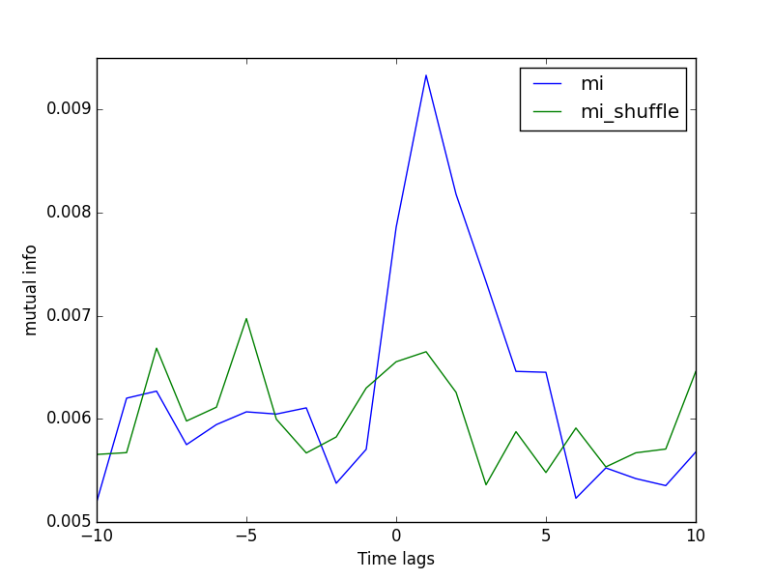
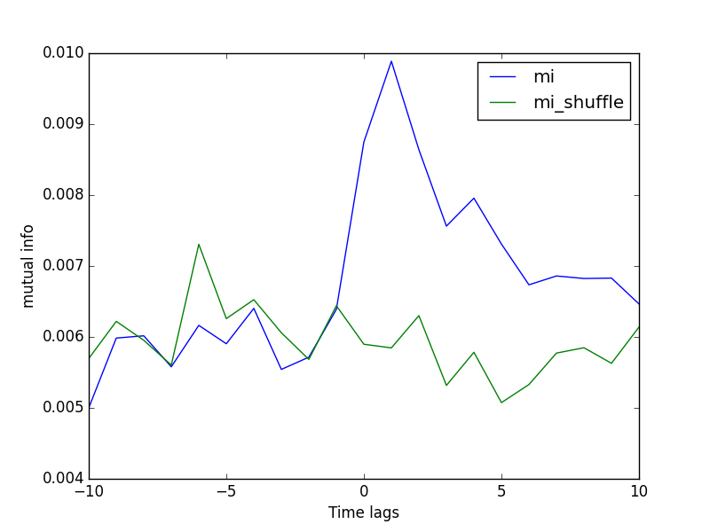
Indication of direction
Poisson Driving Rate | 1.5 kHz
Synaptic Strength | 0.0075
Feedforward Strength | 0.005

Slide 9
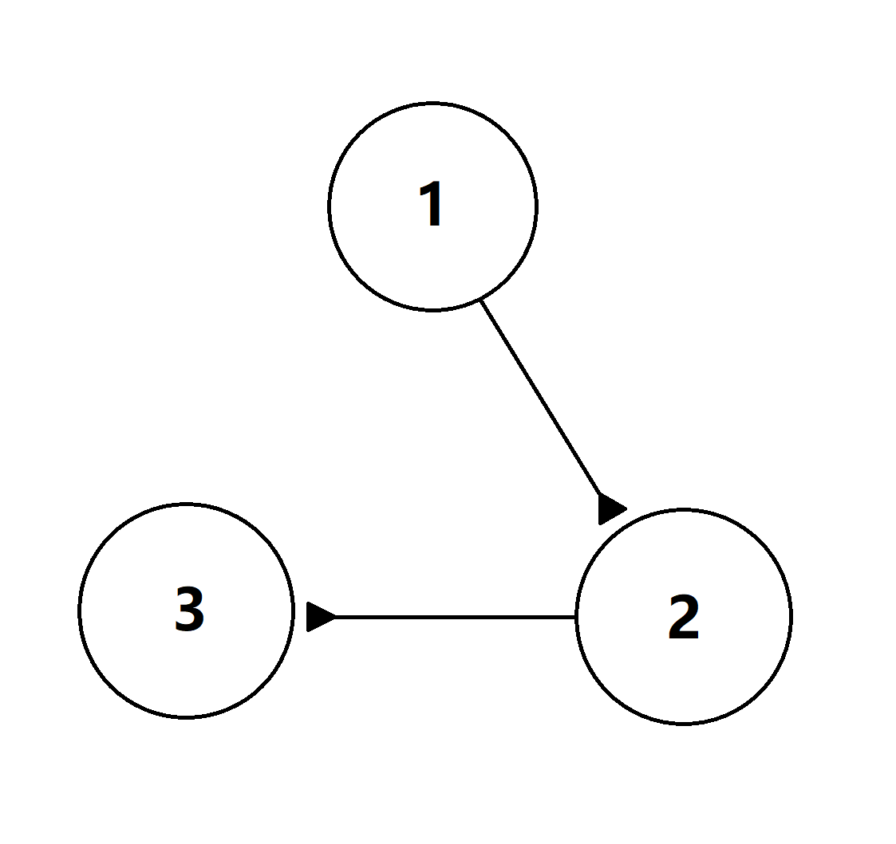
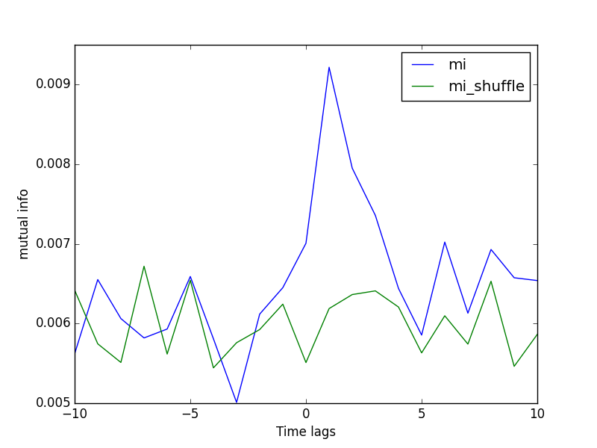
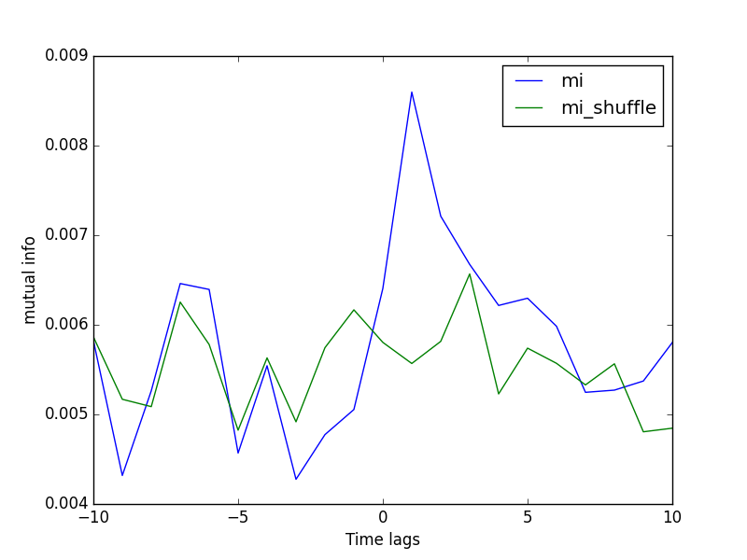
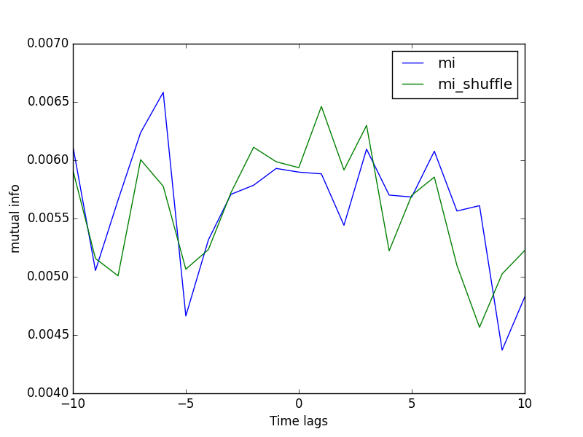
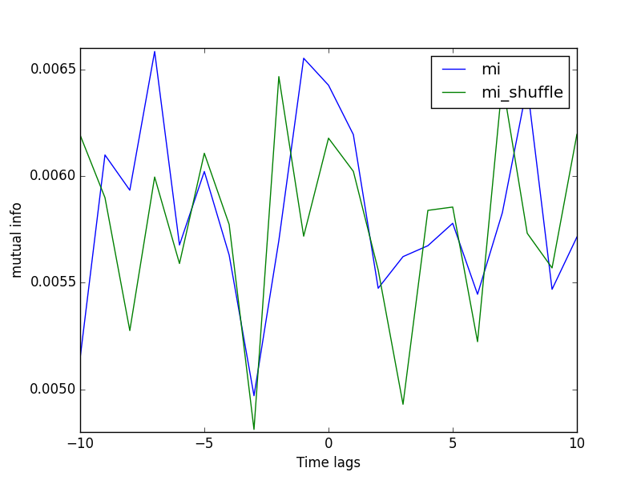
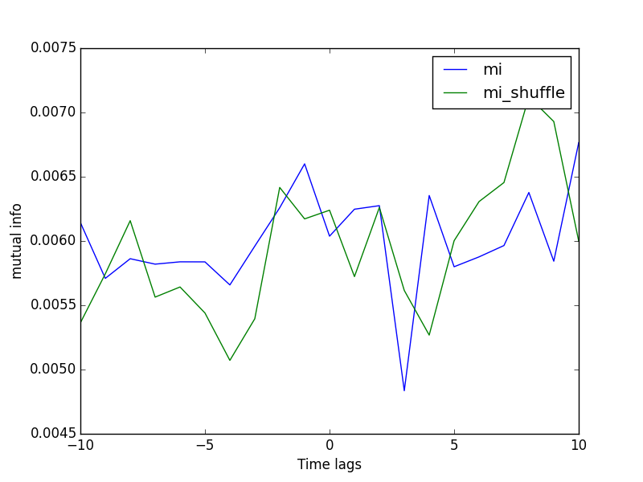
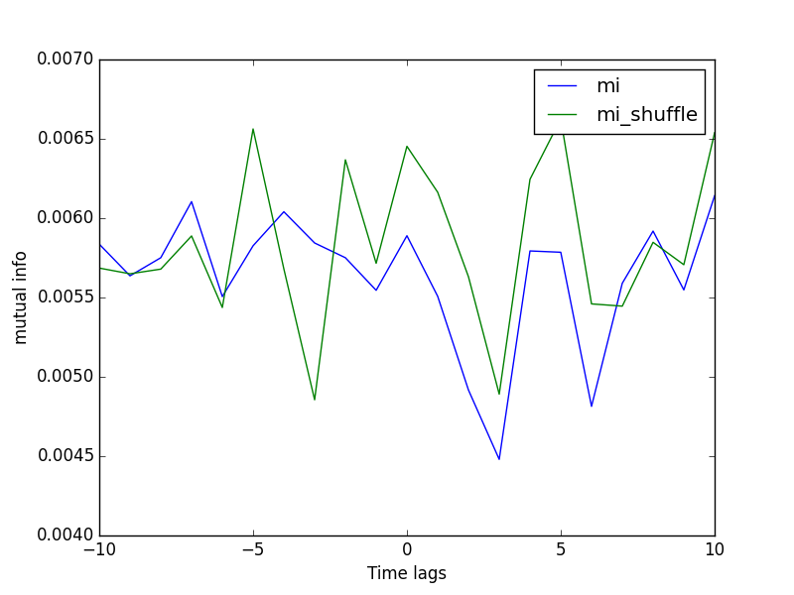
Triple-neuron system
1to2
2to3
1to3
2to1
3to2
3to1

Slide 10
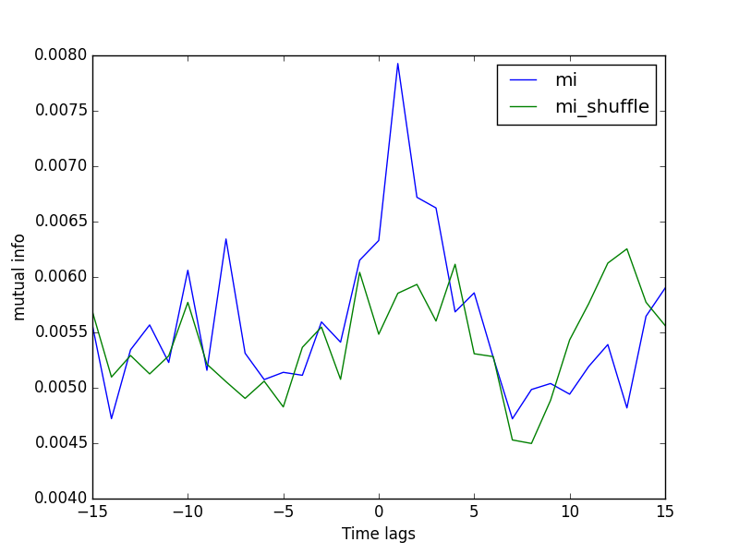
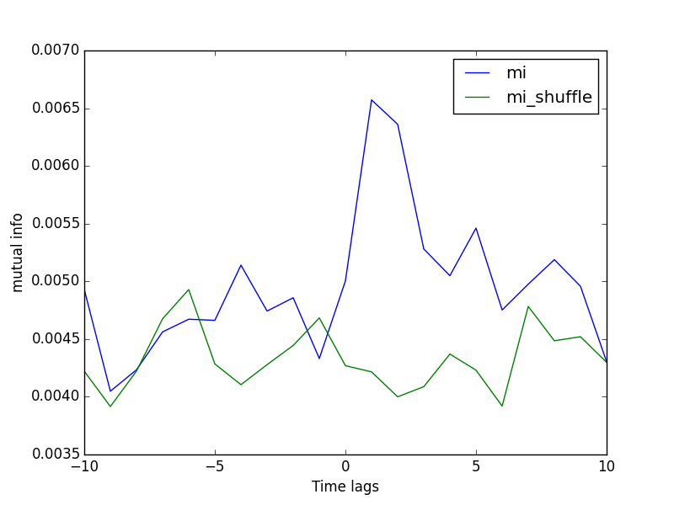
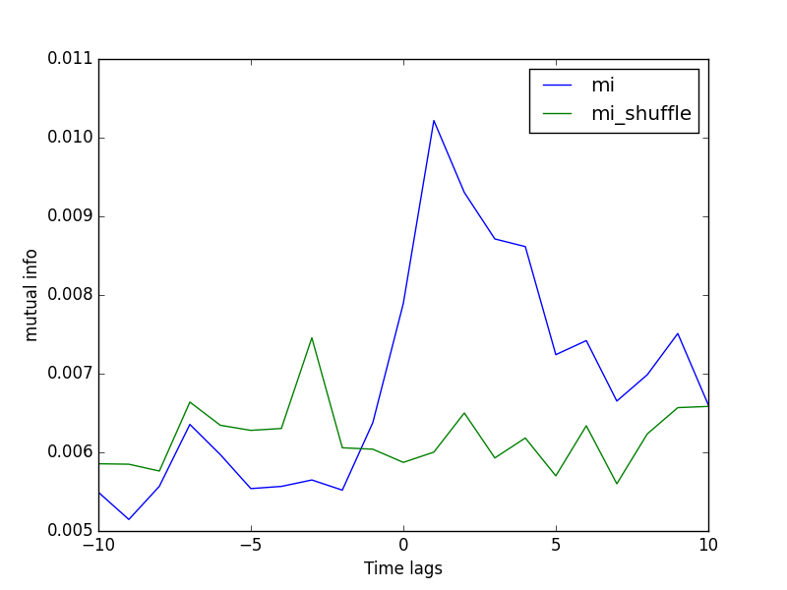
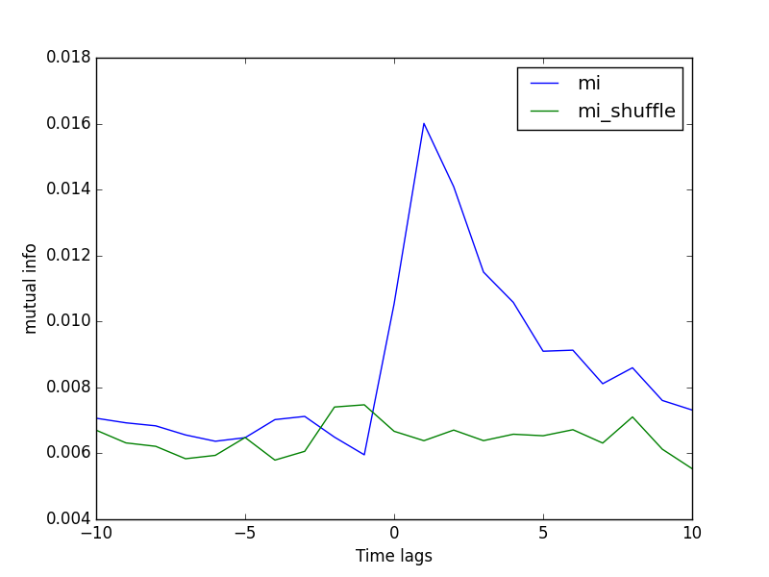
Robustness
0.75 kHz
1.5 kHz
Fix the product of Poisson driving rate and feedforward strength. Change the Poisson driving rate and investigate the change of mutual information pattern
3 kHz
10 kHz

Slide 11
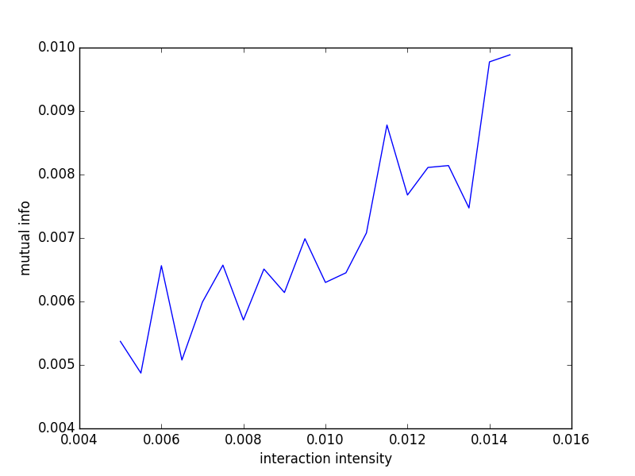
Results
Relation between synaptic strength and values of maximum mutual information
Synaptic strength ranging from 0.005 to 0.0145
Mean firing rate for presynaptic neuron is 10.5 Hz
Mean firing rate for postsynaptic neuron is ranging from 11Hz to 12.3 Hz

Slide 12
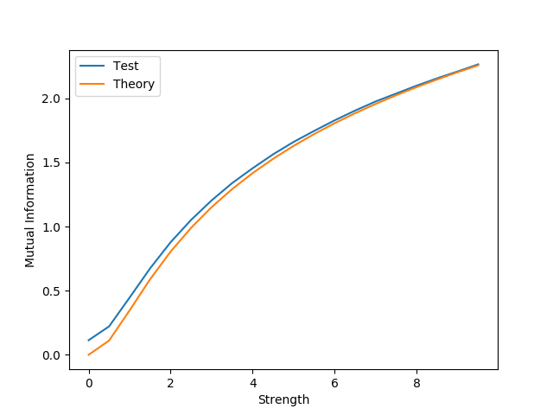


Some Derivations
X_{n} ^{= αX}_{n−1} ^{+ E}_{n}
Y_{n} ^{= βY}_{n−1} ^{+ ξ}_{xy} ^{f (X}_{n−1}^{) + η}_{n}
I(X; Y )= H(X) + H(Y ) − H(X, Y )
$$if α= β, α≪1$$
I(X; Y ) = $\frac{1}{2}$ log(1 + $ξ^{2}$)

Slide 13
Current problems
The resolution of mutual information figure;
A theory to prove my numerical findings;

